Slide 1
SCIQIS Presentation
Romain Brunel

Slide 2
Project goals
Multipartite state description
Creation of class multipartite state,
Visualisation covariance matrix and mean vector,
Computation of the multimode state
Implementation in spatial domain,
Implementation for octo rails,
Implementation for dual rails,
Implementation of gaussian measurement on selected modes and state identification on resulting mode
Implementation of non gaussian measurement on selected modes
Numerical optimisation to search for specific state after gaussian + non gaussian measurement

Slide 3
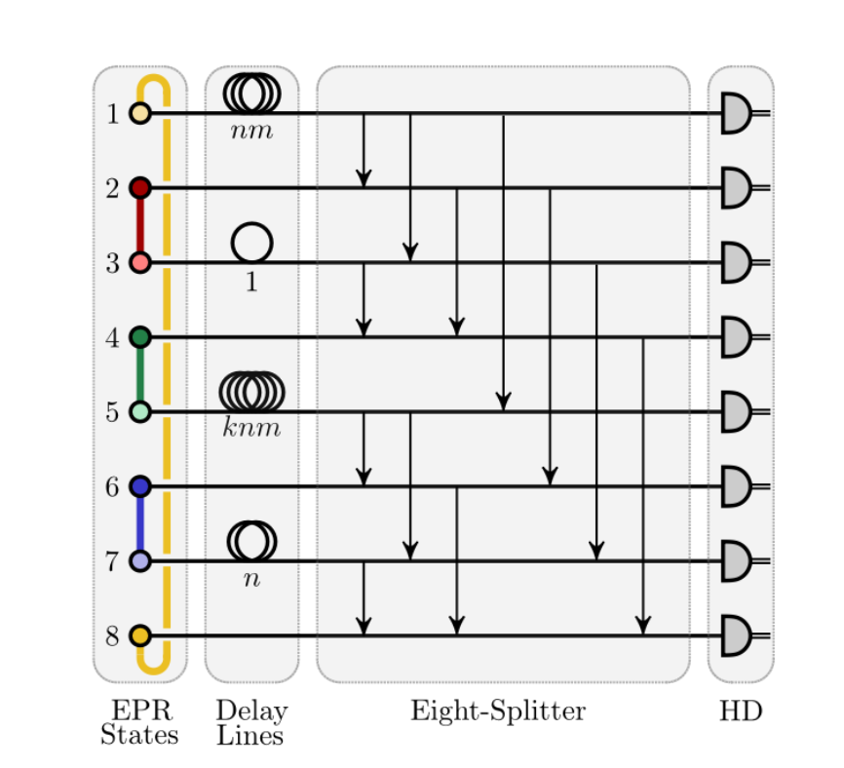
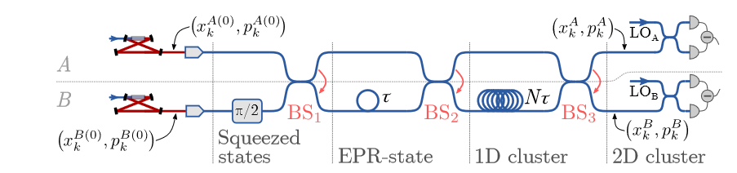
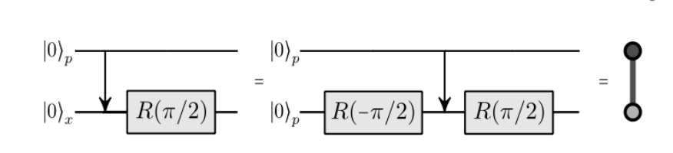
The cluster states
Octo rails
Dual rails
Can be extended to 3D and 4D
4D cluster state

Slide 4
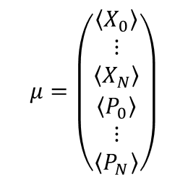
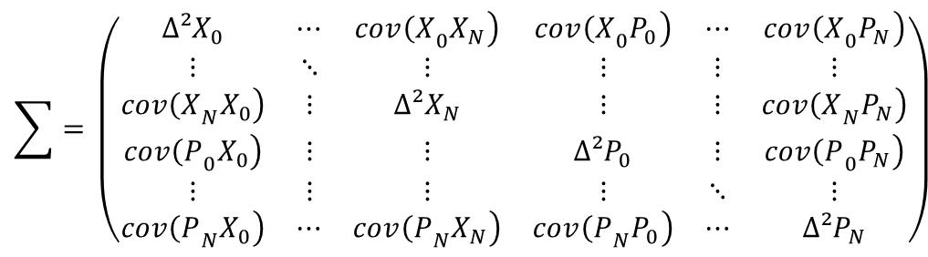

Multipartite state representation
$$\sum{=} \left(\begin{matrix}{Δ²X}_{0} & ⋯ & \left.{{cov\left(X\right.}_{0}X}_{N}\right) & \left.{{cov\left(X\right.}_{0}P}_{0}\right) & ⋯ & \left.{{cov\left(X\right.}_{0}P}_{N}\right) \\ ⋮ & ⋱ & ⋮ & ⋮ & ⋮ & ⋮ \\ \left.{{cov\left(X\right.}_{N}X}_{0}\right) & ⋮ & Δ²X_{N} & ⋮ & ⋮ & \left.{{cov\left(X\right.}_{N}P}_{N}\right) \\ \left.{{cov\left(P\right.}_{0}X}_{0}\right) & ⋮ & ⋮ & {Δ²P}_{0} & ⋮ & \left.{{cov\left(P\right.}_{0}P}_{N}\right) \\ ⋮ & ⋮ & ⋮ & ⋮ & ⋱ & ⋮ \\ \left.{{cov\left(P\right.}_{N}X}_{0}\right) & ⋯ & \left.{{cov\left(P\right.}_{N}X}_{N}\right) & \left.{{cov\left(P\right.}_{N}P}_{0}\right) & ⋯ & {Δ²P}_{N}\end{matrix}\right)$$
$$μ=\left(\begin{matrix}〈X_{0}〉 \\ ⋮ \\ 〈X_{N}〉 \\ 〈P_{0}〉 \\ ⋮ \\ 〈P_{N}〉\end{matrix}\right)$$
For modes described by quadrature: $(X_{i},P_{i})$

Slide 5




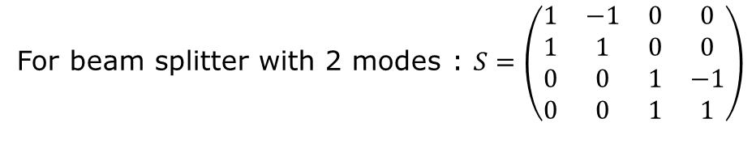





Symplectic transformation
$$\sum{→S\sum{S^{ϯ} }}$$
For beam splitter with 2 modes : $S=\left(\begin{matrix}1 & −1 & 0 & 0 \\ 1 & 1 & 0 & 0 \\ 0 & 0 & 1 & −1 \\ 0 & 0 & 1 & 1\end{matrix}\right)$
$$μ→Sμ$$
$$A→SAS^{ϯ}$$
If I want to apply BS on mode 3 and 7:
$$C→CS^{ϯ}$$
$$C^{T}→{SC}^{T}$$

Slide 6

Indexing the modes
Modes are indexed in temporal order at the input

Slide 7
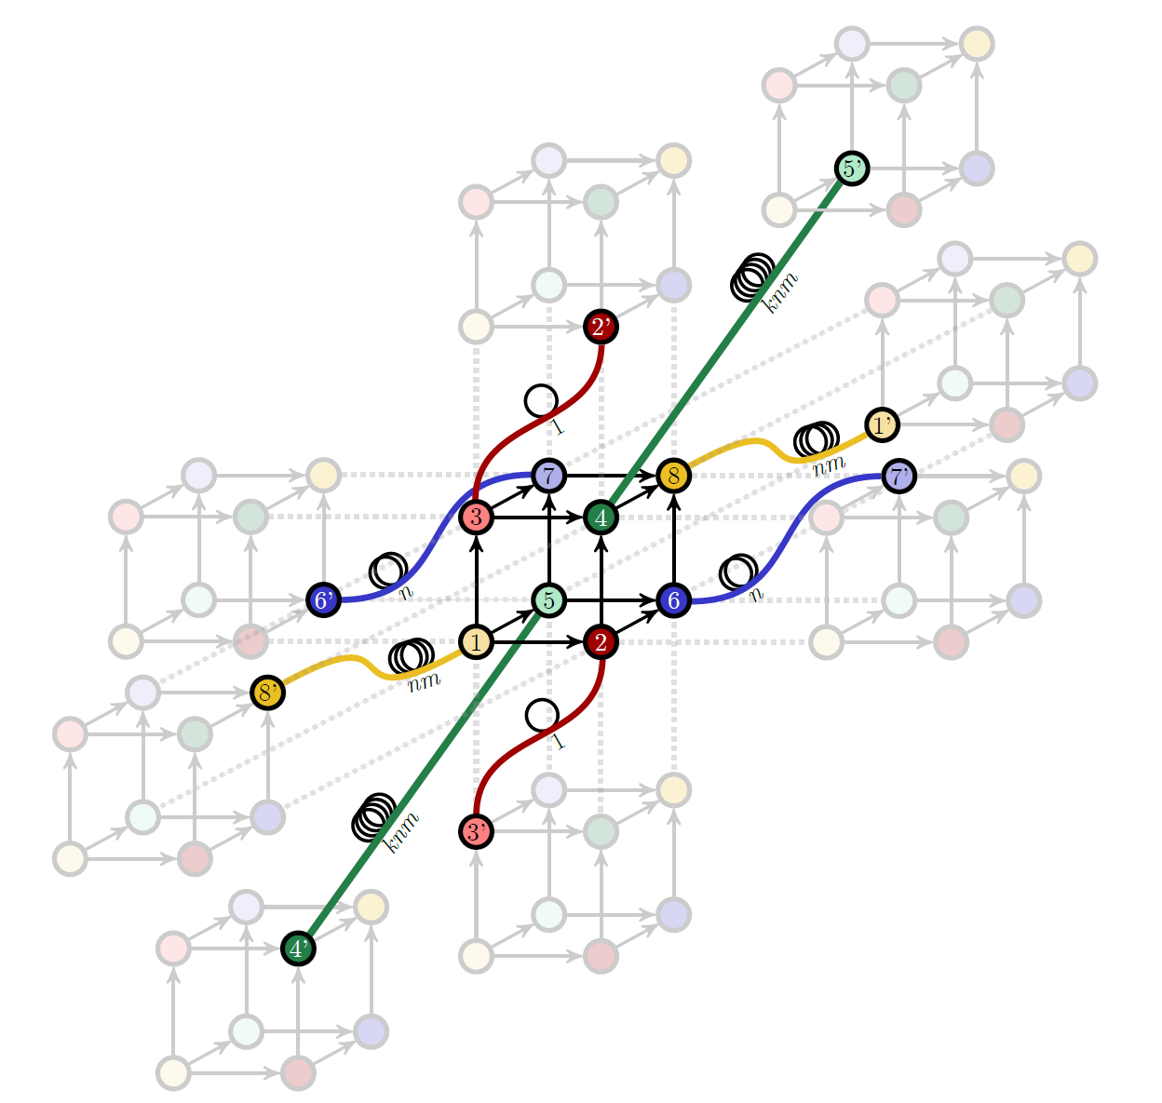
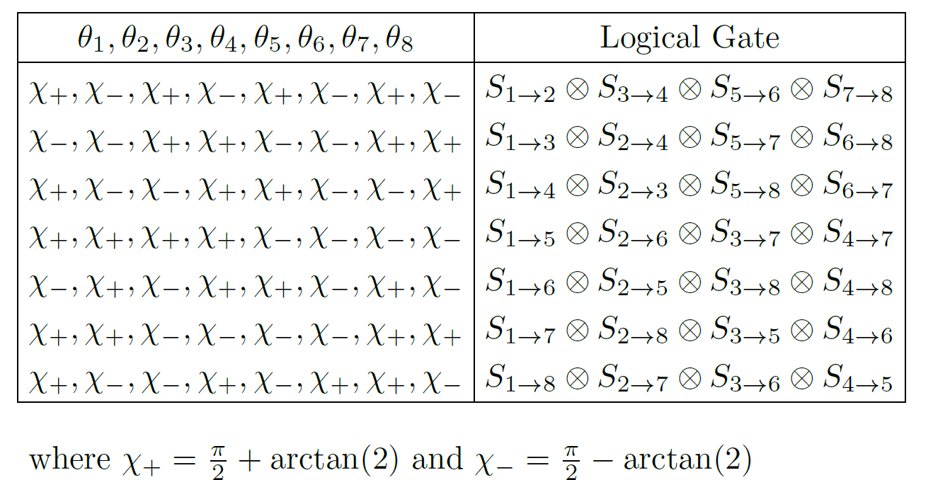
Measurement based gate

Slide 8
Project goals
Multipartite state description
Creation of class multipartite state,
Visualisation covariance matrix and mean vector,
Computation of the multimode state
Implementation in spatial domain,
Implementation for octo rails,
Implementation for dual rails,
Implementation of gaussian measurement on selected modes and state identification on resulting mode
Implementation of measurement-based gates
Implementation of non gaussian measurement on selected modes
Numerical optimisation to search for specific state after gaussian + non gaussian measurement

